Slide 1

You will need a email account with Microsoft Passport supported
Create a new Office 365 Tenant
https://developer.microsoft.com/en-us/office/dev-program

Slide 2

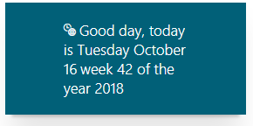
Week day client side web part
Understand the anatomy of a SPFX web part solution
Use external JavaScript libraries
Test our web part in local Workbench
Package and deploy web part to app catalog in our tenant
Download and reuse codebase from GitHub

Slide 3
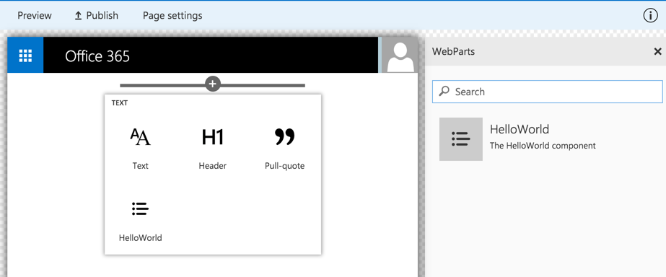
Client-side Web Part Build Flow
nap install generator-sharepoint -g
gulp serve
gulp package-solution
Install SharePoint Generator
Test
Package/Deploy
yo sharepoint
workbench
gulp upload-cdn
Scaffold SharePoint Web Part Project
Local
Package/Deploy
Code
manual upload of the app
Build Web Part Code
UAT / Pre-production
Release using app catalog*
Ship?
Available on Classic and Client-Side Pages

Slide 4
Step by Step SharePoint Framework
Create folder structure using PowerShell
Create a folder on C:\ using PowerShell command
CD\
MD Git
Cd Git
MD spfx-week
Cd spfx-week

Slide 5
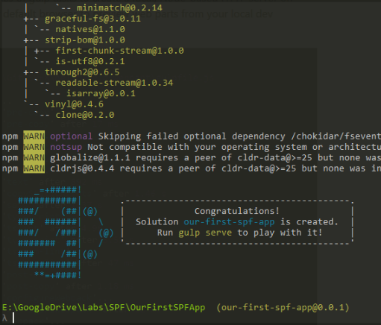

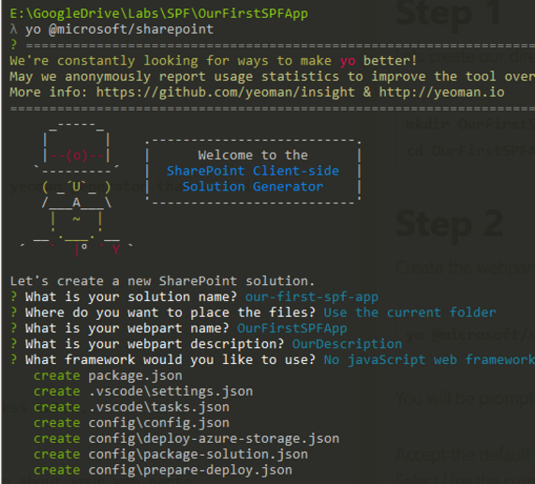
Step by Step SharePoint Framework
Create SharePoint Framework project using Yeoman generator
yo @microsoft/sharepoint

Slide 6

Step by Step SharePoint Framework
Use NPM to include additional JavaScript library for dealing with dates and times
npm install moment

Slide 7

Step by Step SharePoint Framework
Use Visual Studio Code to work with Typescript and understand anatomy of SPFx project structure

Slide 8

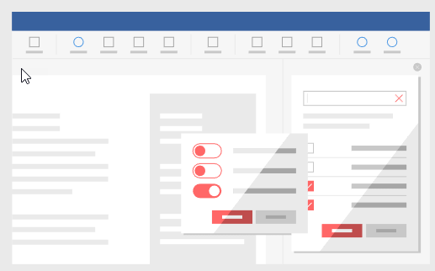

Step by Step SharePoint Framework
Use Office UI Framework to define:
Web Part icon
Web Part content

Slide 9
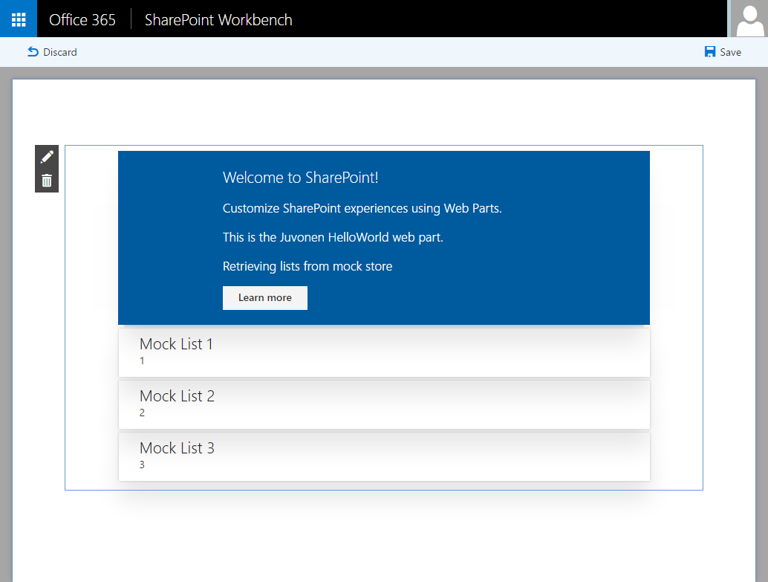
SharePoint Workbench
Use the local Workbench as our development time experience
Test changes immediately even in offline mode

Slide 10
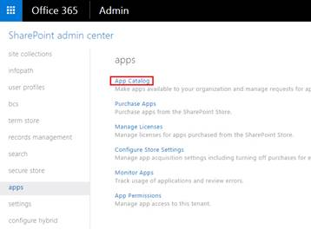
Step by Step SharePoint Framework
Package and Deploy solution using Gulp commands
gulp bundle --ship
gulp package-solution –ship
Upload solution to ap catalog

Slide 11
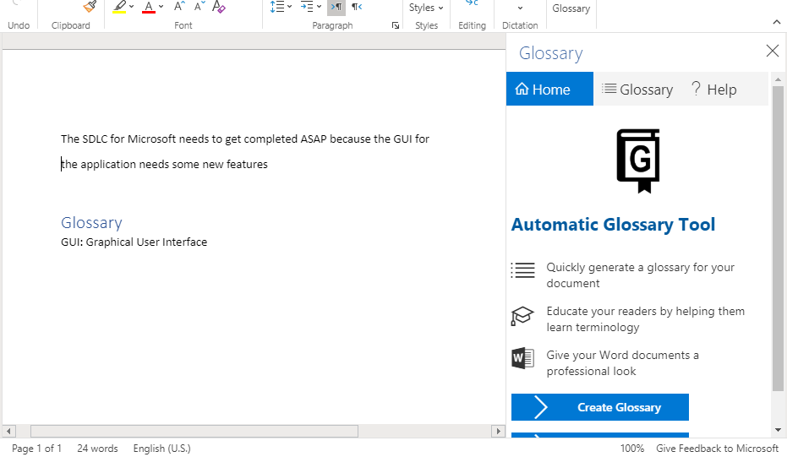
Step By Step Office Add In
Automatic Glossary Tool Add In
Download codebase from git hub
Prepare add in for local testing
Review code base
Perform testing and deployment

Slide 12

Step by Step Office Add In
Using PowerShell
Navigate to your C:\Git folder and download the Glossary codebase by using Git commands
git clone https://github.com/SPDoctor/Glossary.git

Slide 13
Step by Step Office Add In
Include all node dependencies by running command
node start

Slide 14

Step by Step Office Add In
Test the glossary add in by loading:
https://localhost:3000

